Slide 1
The Enterprise Unified Process
Lecturer: Ngo Huy Bien
Software Engineering Department
Faculty of Information Technology
VNUHCM - University of Science
Ho Chi Minh City, Vietnam
nhbien@fit.hcmus.edu.vn

Slide 2

Objectives
To present basic concepts of EUP
To apply EUP in a real world project

Slide 3

Books And Reading
Scott W. Ambler et al. The Enterprise Unified Process: Extending the Rational Unified Process. 2005.

Slide 4
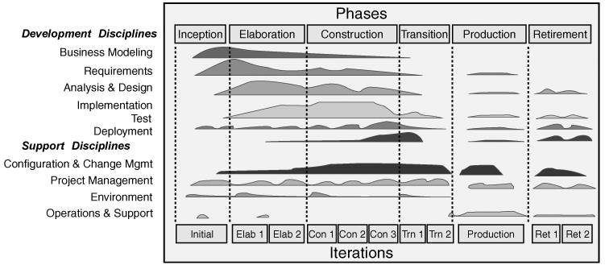
Is Development Enough? [1]
A large portion of the cost and effort for systems, upwards of 75% (Gartner 2000), occurs after systems are deployed.
This includes their operation and support in production, maintenance fixes, and their eventual retirement.
Any organization that wants to be successful at IT needs to look beyond the software DEVELOPMENT lifecycle.

Slide 5
Is Development Enough? [1]
A large portion of the cost and effort for systems, upwards of 75% (Gartner 2000), occurs after systems are deployed.
This includes their operation and support in production, maintenance fixes, and their eventual retirement.
Any organization that wants to be successful at IT needs to look beyond the software DEVELOPMENT lifecycle.

Slide 6
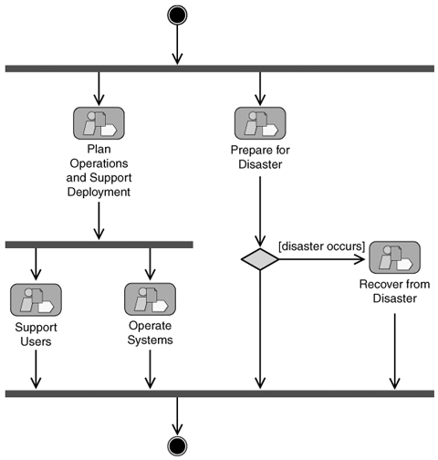
How Do We Operate and Support a System?
HOW?

Slide 7
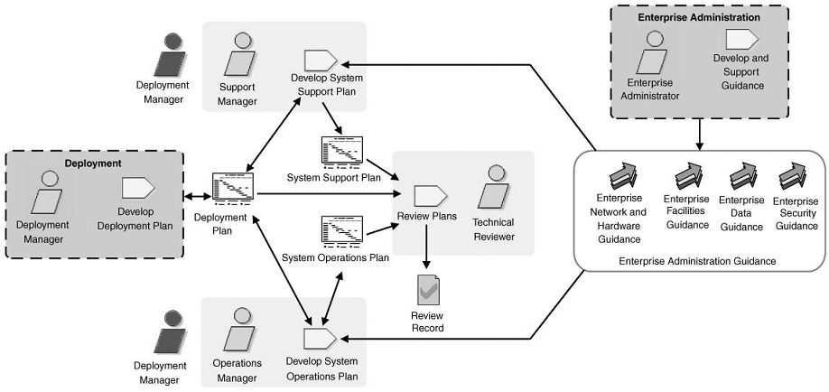
Operations and Support Planning
WHAT?

Slide 8
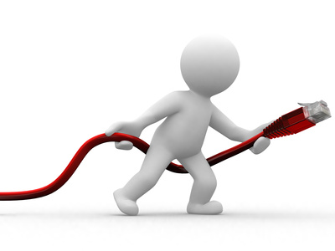
The System Support Plan
How support will be provided: email, online web-based chat service, live call center
Defect reporting and enhancement request strategy
Defect prioritization and resolution time periods
System contact personnel
How to deliver fixes into production outside the scope of an official release

Slide 9
The System Operations Plan
System uptime commitments
Failover strategy
System operating procedures
"For this type of problem, first take this action; if that does not work, take that action. If the problem still exists after X minutes, take this action."
Backup and restore procedures

Slide 10
Tools
System monitoring products
http://www.spiceworks.com/free-network-monitoring-management-software/
https://www.pingdom.com/
Help desk suite
http://www.spiceworks.com/free-help-desk-software/
https://www.zendesk.com/

Slide 11


Slide 12
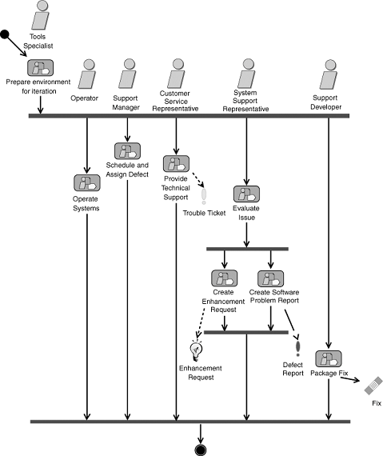
How Do We Maintain a System?

Slide 13
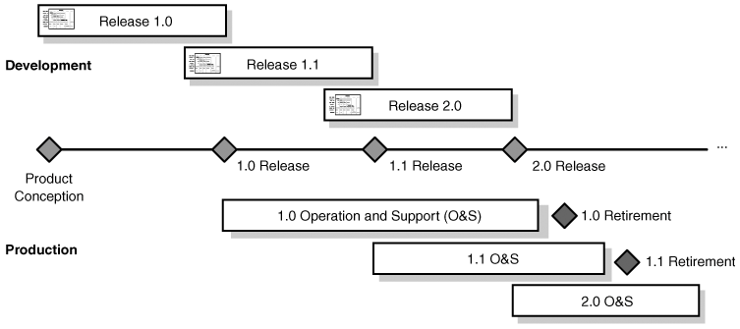
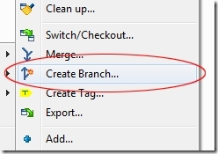
Handling Concurrent Releases
The Production phase for a system ends when support for that release of the system has been withdrawn.

Slide 14

We Did Not Create this System

Slide 15
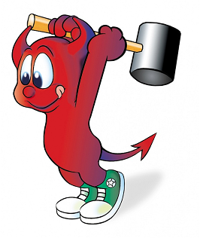
We Want to Remove a System
Systems are retired for various reasons: they are replaced by new ones, they become redundant, or they simply become obsolete and are no longer needed.

Slide 16
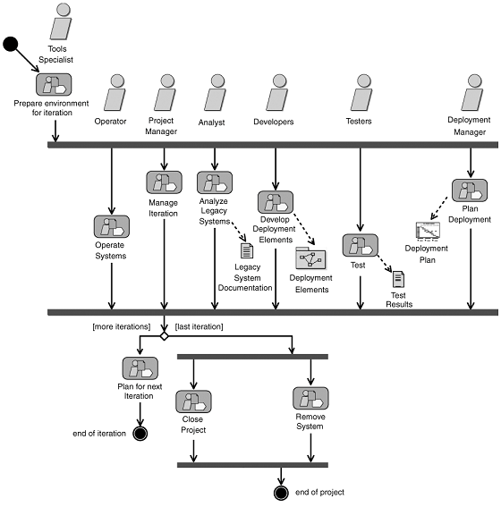
How to Remove a Release or a System?
Programs to remove the system and its data

Slide 17
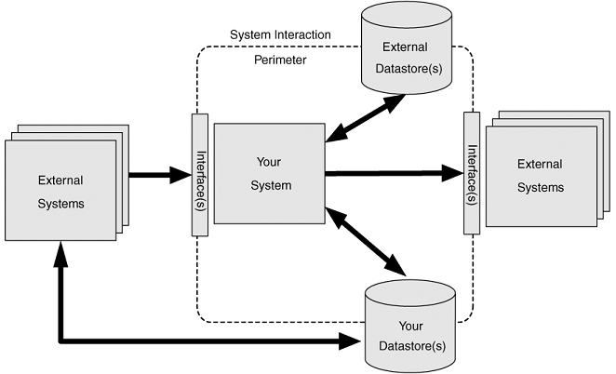
Be Careful About This
Do a proper analysis and design

Slide 19
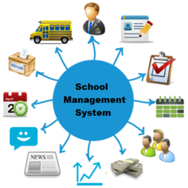


Enterprise Projects Failure

Slide 20
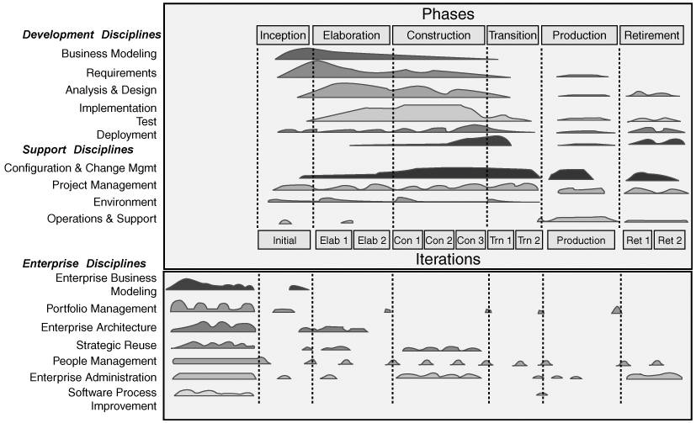
We Have More Than One System

Slide 21
How to Capture Enterprise Level Business Needs?
Artifact | Description
Enterprise business rules specification | The definition of the constraints that influence or guide the everyday workings of an organization.
Enterprise business process model | Captures the fundamental business processes, the external entities (customers, suppliers, partners, or competitors), and the major workflows between them.
Enterprise domain model | Depicts the main business entities of interest to an organization and their relationships.
Enterprise mission statement | A statement of the strategies to be followed to achieve the enterprise vision.
Enterprise vision | A statement of the primary goal(s) of an organization.
Organization model | A definition of the location, positions, organizational units, and their interrelationships within an enterprise.

Slide 22
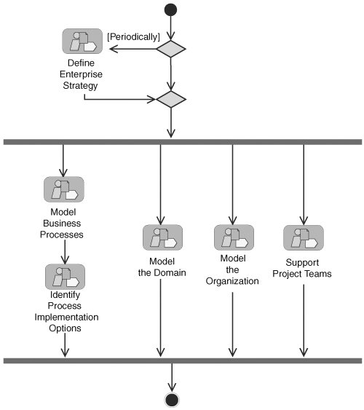
How To Model Enterprise Business
HOW?
HOW?
HOW?

Slide 23
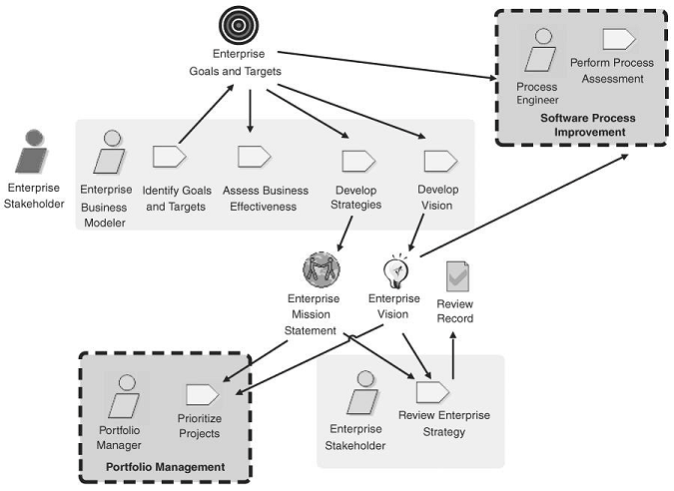
Define Enterprise Strategy
WHAT? – Values.

Slide 24
A Collection of Martial Arts Studios
The vision might read, "The XYZ Schools will help their students improve their minds, bodies, and spirits through training in the martial arts.“
The mission statement may contain the following points:
XYZ Schools will offer training in Goju Ryu karate, Kobudo, Ju Jitsu, and Taoist Tai Chi.
Both adults and children (at least six years of age) will be encouraged to train.
Martial arts philosophies and history will be intertwined into training classes.
Respect for family, self, and country will be encouraged in training classes.
XYZ Schools will work with external experts to bring specialized skills to their students.
Camaraderie between students will be encouraged. We should be able to have fun while we're learning.

Slide 25
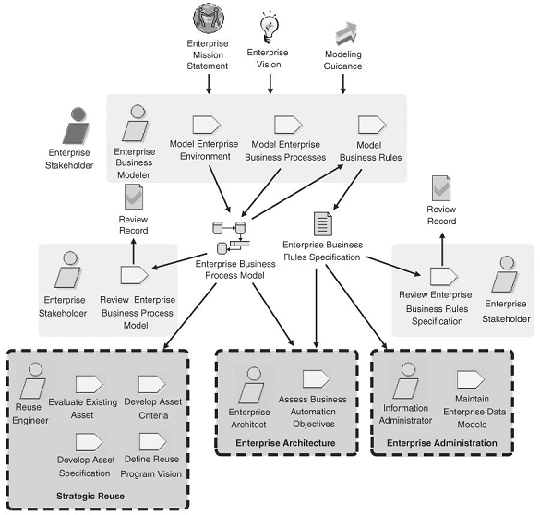
Model Business Processes

Slide 26
Business Process Modeling Tools
Data flow diagram (DFD)
Integrated Computer-Aided Manufacturing Definition (IDEF0) diagram
Unified Modeling Language (UML) 2.0 Activity diagram
Use case model
Value stream map
Business Process Modeling Notation (BPMN)
Detailed modeling:
Business process execution language (BPEL)
Object constraint language (OCL)

Slide 27
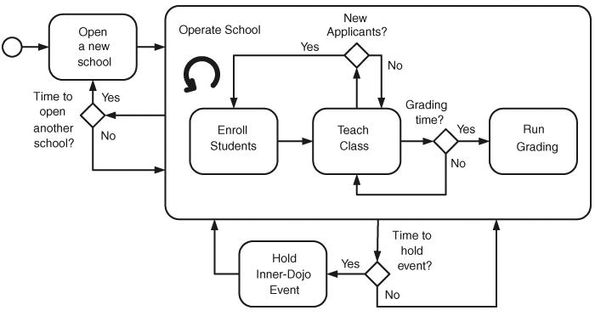
A Business Process Diagram for XYZ Schools

Slide 28
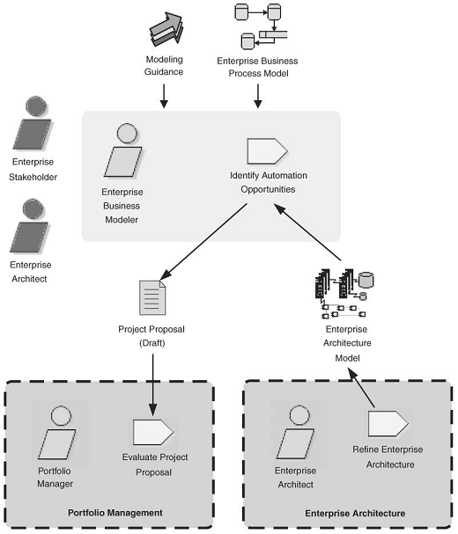
Identify Process Implementation Options
WHAT TO AUTOMATE?

Slide 29
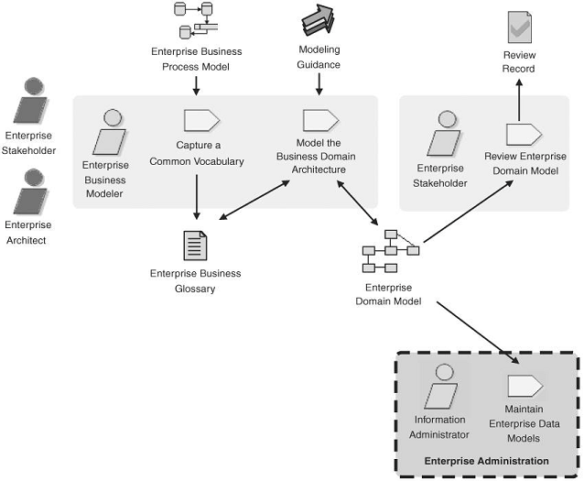
Model the Domain

Slide 30
Domain Modeling Tools
Class Responsibility Collaborator (CRC) cards
Logical Data Model
UML 2 Class Diagram
UML 2 Component Diagram

Slide 31
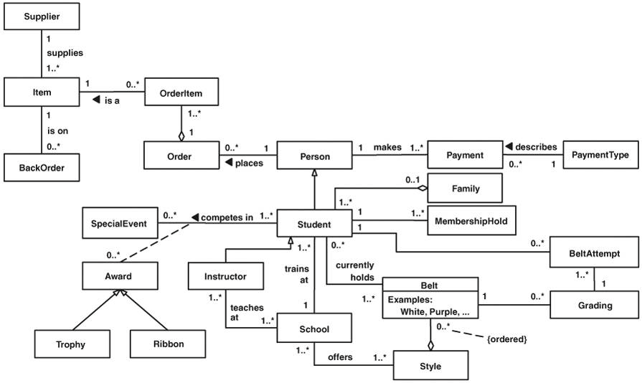
An Enterprise Domain Model for XYZ Schools

Slide 32
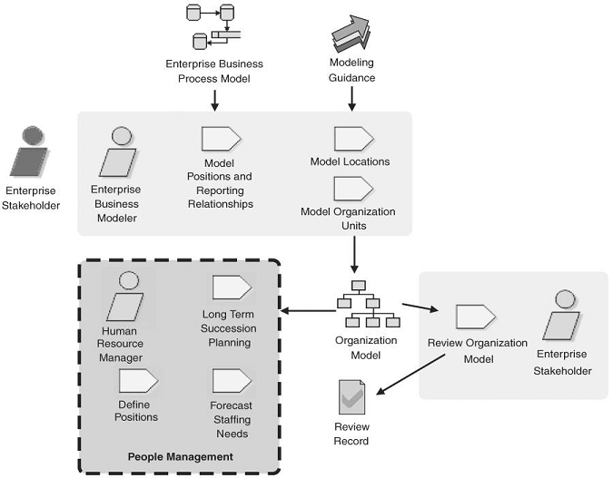
Model the Organization

Slide 33
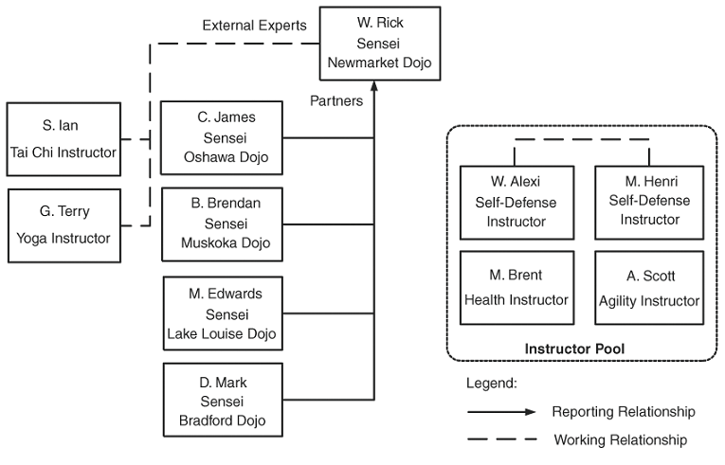
An Organization Model for XYZ Schools

Slide 34

Thank You for Your Time

